Slide 1

Data Pulse
A Decentralized File-Sharing Platform
Presenting:
Rotem Porat
Ofek Ben Avraham
Supervisor:
Ronen Zilber
01

Slide 2
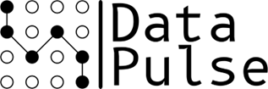
Introducing Data Pulse
Decentralized file-sharing platform.
Leveraging peer-to-peer (P2P) networking.
Fast, efficient, and reliable file transfers.
Users share load and resources.
Intuitive and easy-to-navigate interface.
02
Notes:
DataPulse is a decentralized file-sharing platform designed to make sharing digital files more efficient and user-friendly. By using peer-to-peer networking, DataPulse allows users to share and download files directly from each other without relying on a central server. This approach helps improve download and upload speeds while ensuring that the system is easy to use for everyone.

Slide 3
Objectives
Develop a decentralized file-sharing platform.
Focus on a user-friendly interface.
Ensure secure and reliable file transfers.
Enhance performance for both uploads and downloads.
Maintain high data availability and system reliability.
03
Notes:
The primary objective of our project is to develop a decentralized file-sharing platform that combines efficient file distribution with a user-friendly interface. Our focus is on creating a secure, reliable system that improves both download and upload speeds while ensuring high data availability and user friendly interface.

Slide 4

Existing Conditions
The growing of digital file sizes.
Bandwidth limitations in single-server systems.
Inefficiencies in traditional file distribution.
BitTorrent and µTorrent.
04
Notes:
today’s in the digital world, we’re seeing a rapid increase in the size of files—whether videos, software, or other forms of digital content. This growth poses significant challenges for traditional file-sharing systems, especially those relying on a single server for uploads and downloads.
One major issue is the bandwidth limitation of these single-server systems. When multiple users attempt to download or upload large files at the same time, the server can become overwhelmed, resulting in slower download speeds and a poor user experience.
Moreover, traditional file distribution methods are often inefficient. These methods don’t fully utilize the potential of modern internet speeds, and the pressure on a single server can create bottlenecks, further slowing down the process.
To address some of these issues, platforms like BitTorrent and µTorrent introduced decentralized methods that improve download speeds and reduce server load. However, both platforms have their own limitations—particularly in user interface complexity, which can be challenging for less technical users.
With DataPulse, we aim to build on the strengths of these established platforms while providing a more intuitive and accessible user experience.

Slide 5
Need for DataPulse
A decentralized approach to file sharing.
Enhanced performance through optimized bandwidth utilization.
Tracker-based system for efficient peer discovery.
Scalable and secure file-sharing solution
User friendly UI interface
05
Notes:
First, we use a decentralized approach, distributing the load across peers, making the system stronger under high traffic.
We optimize performance by allowing downloads from multiple sources, improving speeds and efficiency.
The tracker system helps users quickly find peers with the files they need.
Lastly, we focus on a user-friendly interface.
In the next slides, we'll explain how we achieve these goals.

Slide 6
Research Approaches
Literature Review.
Technological Feasibility.
User Feedback.
06
Notes:
Our research for DataPulse started with a literature review to understand existing file-sharing technologies and identify areas for improvement.
Next, we assessed the technological feasibility by researching the protocols, frameworks, and programming languages that best for out project.
Finally, we gathered user feedback to refine our design and ensure it works well for actual users.

Slide 7
Development Phases
Initial Research.
Design and Test Planning.
Test-Driven Implementation.
Continuous Testing and Refinement.
07
Notes:
Our development process will use Test-Driven Development, or TDD, a methodology where tests are written before code. TDD is well-suited for our project because it helps ensure that each part of the system is completely tested and reliable from the start.

Slide 8
Algorithms
Technology
P2P Networking Algorithms.
Encryption Algorithms.
Error Correction.
Backend - Python.
Frontend - Angular.
Database - MongoDB.
Networking - WebRTC
08
Notes:
For algorithms, we’ll start with P2P networking algorithms to manage peer discovery and data transfer efficiently.
In terms of encryption, DataPulse will use AES and SSL to ensure robust security and privacy. AES is a widely-used encryption standard that will protect the data stored and shared within the network. SSL will be used to secure data transmission between peers, encrypting the data as it moves across the network to prevent interception or unauthorized access.
Additionally, error correction algorithms will maintain data integrity and availability, even if some peers go offline or errors occur during transfers.
On the technology side, Python is our choice for the backend, offering flexibility and strong support for web applications. Angular will power the frontend, ensuring a responsive and dynamic user interface. MongoDB will be used for the database, known for its scalability and capacity to manage large datasets. Finally, WebRTC will handle networking, enabling real-time peer-to-peer communication essential for a decentralized system.

Slide 9
Stages
System Design.
Backend Development.
Frontend Development.
Integration and Testing.
Deployment.
09
Notes:
These are the key stages of our development process, as outlined in the points on the slide. Each stage represents a crucial step in bringing DataPulse to life, so there’s no need to expand beyond them.

Slide 10
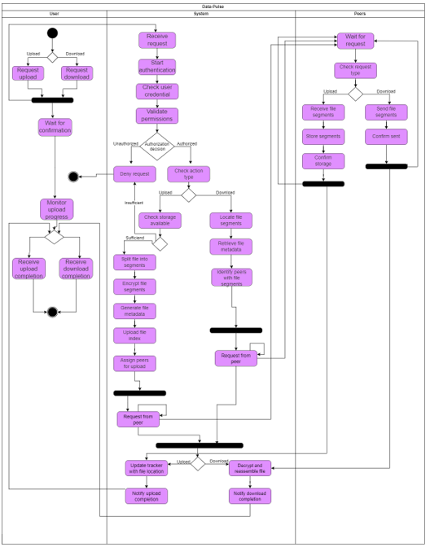
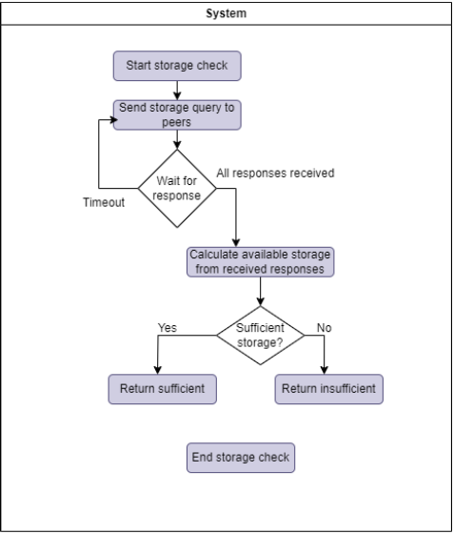
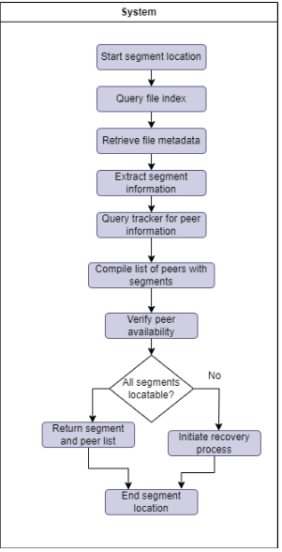
Activity
10
Notes:
Our system has three main parts: Users, the System, and Peers.
These diagrams show how things work in the DataPulse system using both ACTIVITY and SEQUENCE diagrams. Now, let's focus on the UPLOAD FILE process.

Slide 11
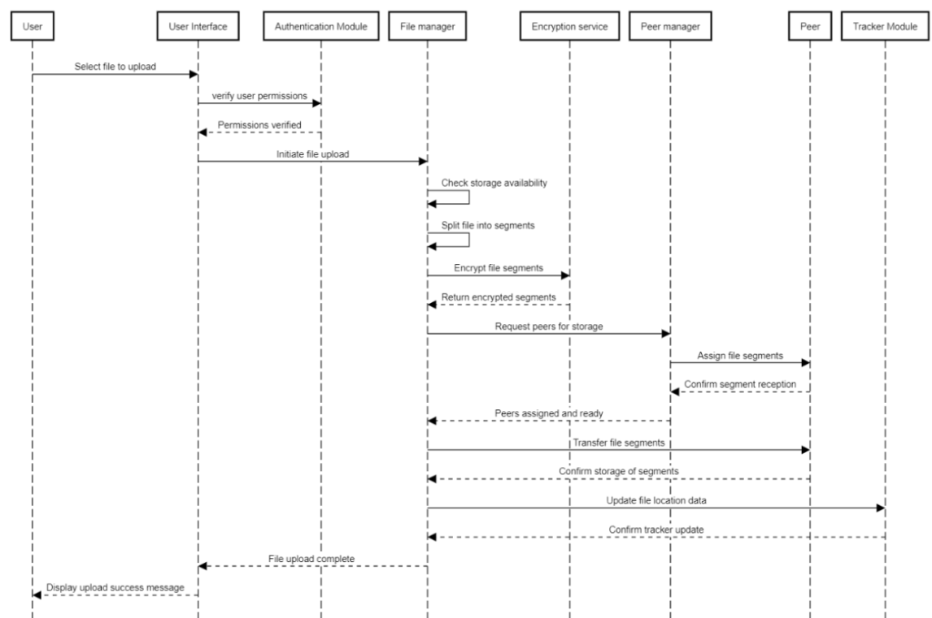
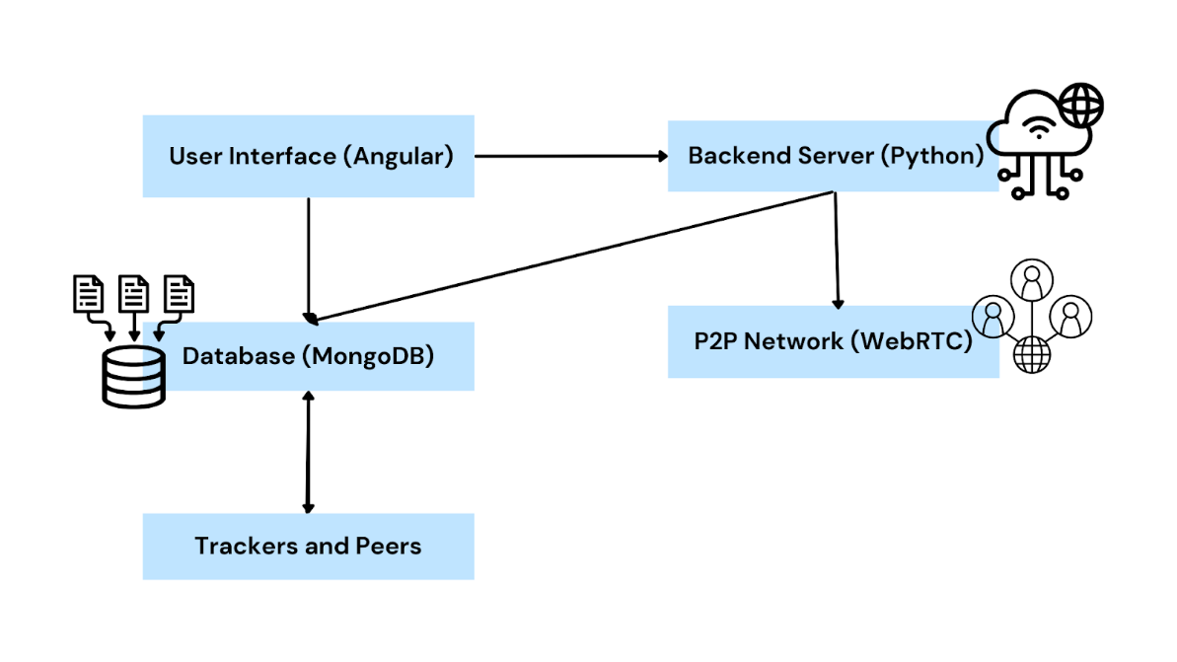
Upload File Sequence
11
Notes:
The user starts by selecting a file in the Angular-based UI. The UI sends this request to the backend server in Python, which checks the user’s permissions with the MongoDB database. Once verified, the backend checks for storage space in the WebRTC-based P2P network. The file is then split into segments, encrypted, and sent to peers for storage. The database tracks where the file is stored, and finally, the system confirms the upload and shows a success message to the user in the UI.

Slide 12
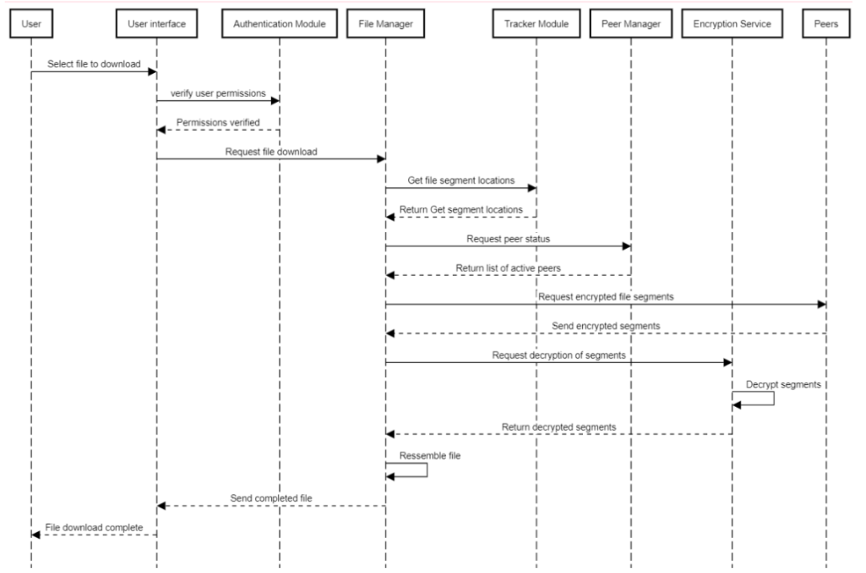
Download File Sequence
12
Notes:
This is the process for downloading.

Slide 13
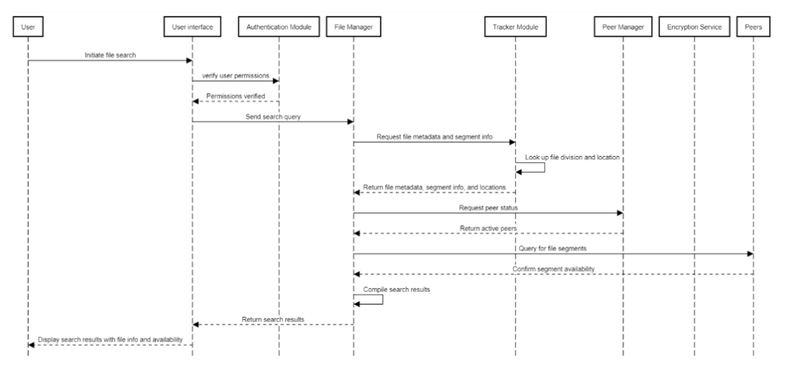
Search Sequence
13
Notes:
This is the process for search

Slide 14
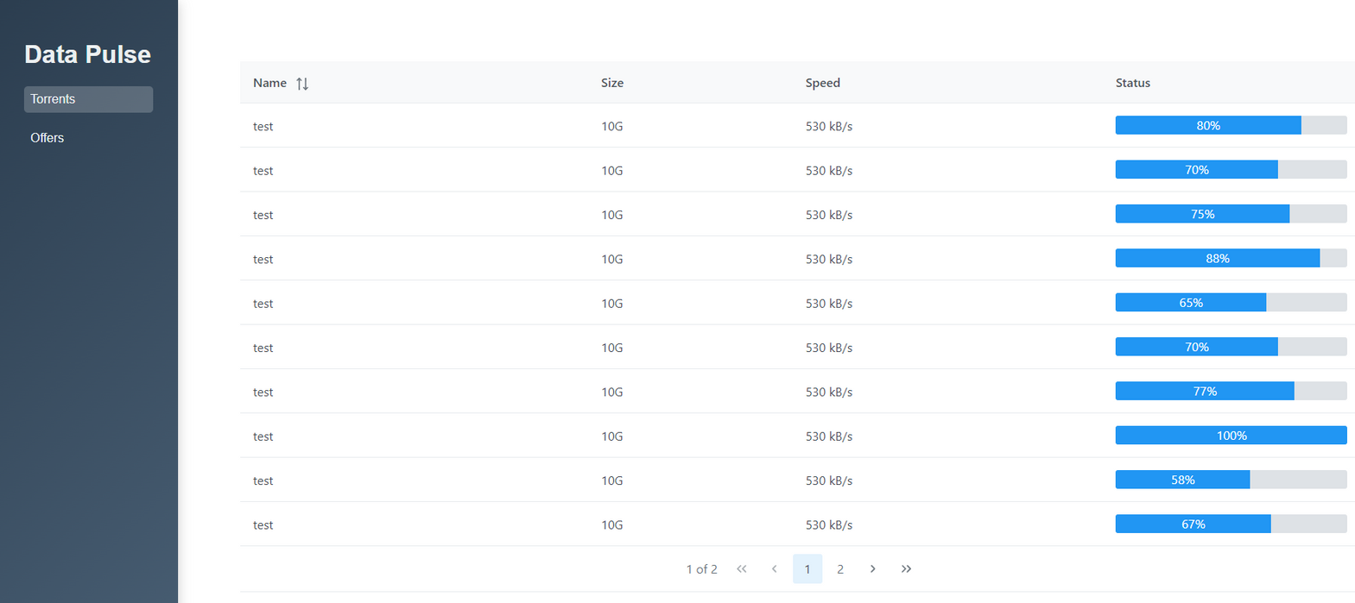
Torrents Screen
14
Notes:
On the left, there’s a sidebar with two options: Torrents and Offers.
The Torrents section shows details like file name, size, download speed, and current progress.
The interface is designed to be user-friendly, with all the important information easy to find.

Slide 15
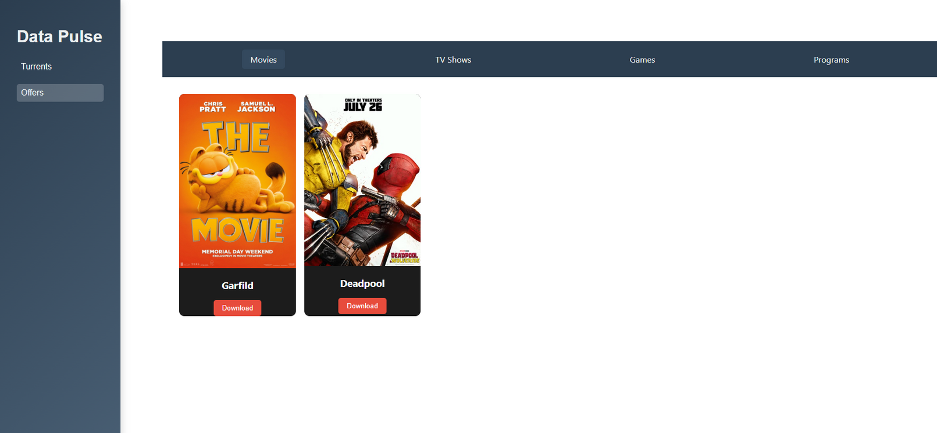
Offers Screen
15
Notes:
This slide shows the design for the Offers screen in DataPulse.
At the top, there’s a navigation bar with categories like Movies, TV Shows, Games, and Programs, making it easy to find specific offers.
The main section shows offers as cards with download buttons, giving a Netflix-like browsing experience. This design makes it simple for users to find and download the content they want.

Slide 16
Innovative Features
Netflix-like Experience.
Simplified Navigation.
16
Notes:
DataPulse stands out from other file sharing platforms with several features.
First, it offers a Netflix-like experience where users can easily browse and select files just like streaming movies. It makes file sharing more fun and easy to use.
Also the navigation will be simple. Unlike other platforms that have complicated menus, DataPulse will have a user-friendly interface that makes it easy to manage downloads and uploads.

Slide 17
Anticipated Challenges
Handling High Traffic.
Ensuring Data Integrity.
Security Threats.
User Feedback Integration.
17
Notes:
While building DataPulse, we expect to face some challenges.
First, handling high traffic ,we need to ensure it stays fast and works well, even when many users are connected at the same time.
Next, ensuring data integrity is important. We need to make sure the data is correct, even when users join or leave the network.
Security is always important in file sharing. We will use encryption and other security protocols to protect user data.
Finally, listening to user feedback is key to improving the platform. We will work on finding the right balance between what users want and keeping the system running well.

Slide 18
Testing Process
Unit Testing.
Integration Testing.
System Testing.
Performance Testing.
Security Testing.
Usability Testing.
18
Notes:
We designed a testing process to make sure DataPulse is working well and is secure.
First, unit testing to check that each part of the system is working well.
Next, integration testing to make sure all parts of the system work well together.
system testing, where we will check that it meets all the requirements.
performance testing to see if it works well with many users.
Security testing to find and fix security issues.
Finally, usability testing to make sure the interface is easy to use and gives all users a friendly experience.

Slide 19
Execution Method
Prepare the Test Environment.
Define Test Cases.
Execute Tests.
Analyze Results.
Address Issues.
Retest.
19
Notes:
The testing process will follow a clear plan:
First, we will create a system that is like the real system where people will use the platform.
Next, create test cases that cover all the important parts of the platform, making sure we test every possible function and issue.
Once the test cases are ready, we will carefully run the tests to find bugs, performance issues or security issues.
After the tests, we will look at the results to see how the system is working and find out what needs to be fixed.
After that, we will fix all the problems we found during the test and improve the system.
Finally, we'll check back to make sure the issues are resolved

Slide 20
Expected Results
Functional Components.
High Performance.
Secure Data
User-Friendly Interface
20
Notes:
Here are the results we expect in our system

Slide 21
Thank you for listening.
21

